Slide 1
Dr P K Sharma
Professor
Department of Anatomy
K G M U , Lucknow

Slide 2
INTRODUCTION
Ball and socket type of synovial joint
Multiaxial
Range of motion restricted (weight bearing)

Slide 3
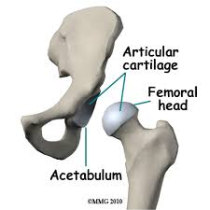
BONES
Femoral head ->1/2 of sphere-Ball
Acetabulum-vinegar cup-Socket
Head of the femur articulates with acetabulum

Slide 4
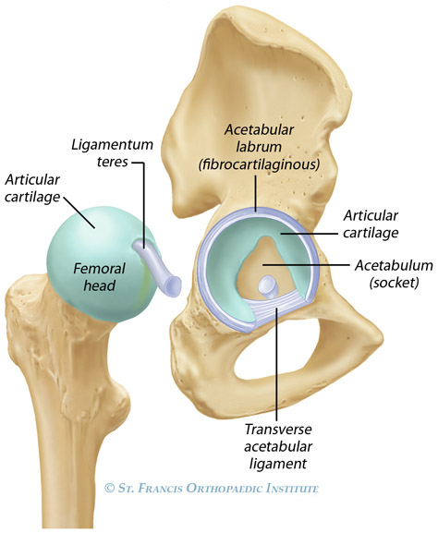
ARTICULAR SURFACES
Head of Femur- hyaline cartilage
Nonarticular-fovea capitis
Acetabulum-
Articular surface -horse shoe shaped hyaline cartilage covered

Slide 5
LIGAMENTS OF HIP JOINT
Capsular ligament(joint capsule)
Ilifemoral ligament-ligament of Bigelow(strongest)
Pubofemoral ligament
Ischiofemoral ligament
Transverse acetabular ligament
Acetabular labrum
Ligamentum teres femoris.

Slide 6
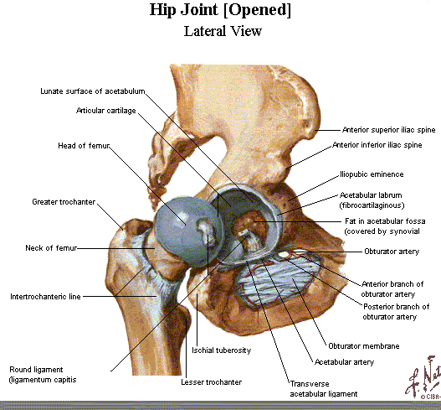
CAPSULAR LIGAMENT
Strong dense fibrous
sac
Inner fibres circular,
outer fibres longitudnal
ATTACHMENTS
Hip Bone-
Femur -
.

Slide 7
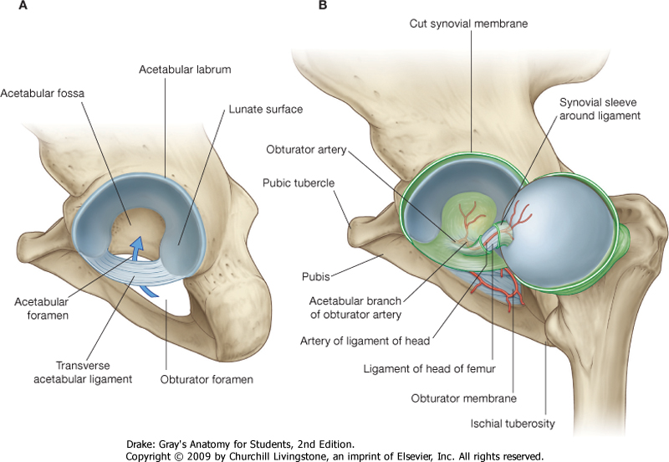
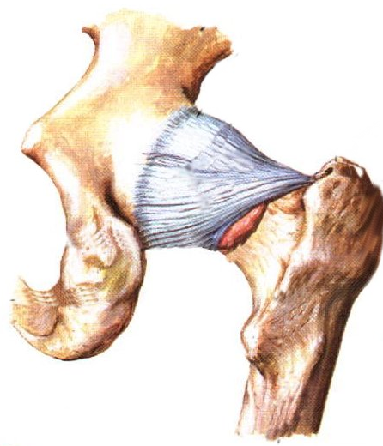
Hip Ligaments
ischiofemoral ligament
Resists adduction and internal rotation.
Note: none of these ligaments restrict flexion.
posterior view of right hip

Slide 8
ILIOFEMORAL LIGAMENT
Ligament of Bigelow
strongest
Y shaped
Stem
Medial (vertical)
Lateralband(oblique)
intermediate thin stratum.
Anteriorly blends with capsule
Prevents hyperextension of hip

Slide 9
PUBOFEMORAL LIGAMENT
Base –iliopubic eminence,superior
pubic ramus,obturator crest.
Blends with capsule deep to medial band of iliofemoral.
Resists abduction and some external rotation.

Slide 10
ISCHIOFEMORAL LIGAMENT
Weak
Supports capsule from behind
From ischium, fibres spiral behind femoral neck attach to greater trochanter

Slide 12
OTHER LIGAMENTS
A-Round lig/lig.teres femoris
B-Acetabular labrum
C-transverse acetabular ligament
B
A
C

Slide 13
STABILITY OF HIP JOINT
Depth of articular socket
Strong lig.-
Muscles-
Length ,obliquity of femur neck.

Slide 14
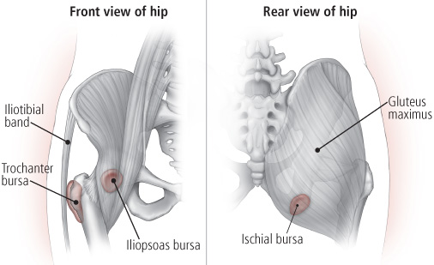
BURSAE AROUND HIP JOINT
Subgluteal/ischial bursa
Subpsoas/iliopsoas

Slide 15
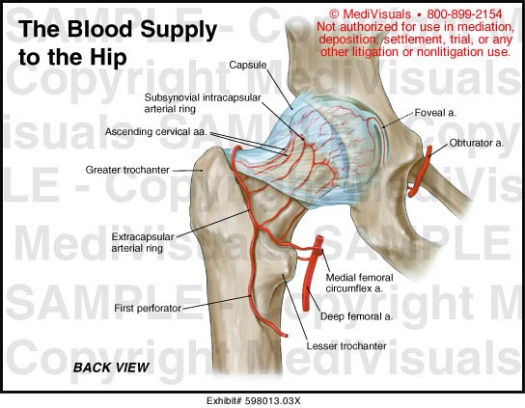
ARTERIAL SUPPLY
Medial circumflex
femoral
Lateral circumflex
femoral
Obturator artery
Superior
Inferior gluteal
Nutrient artery
Notes:
Blood supply best

Slide 16
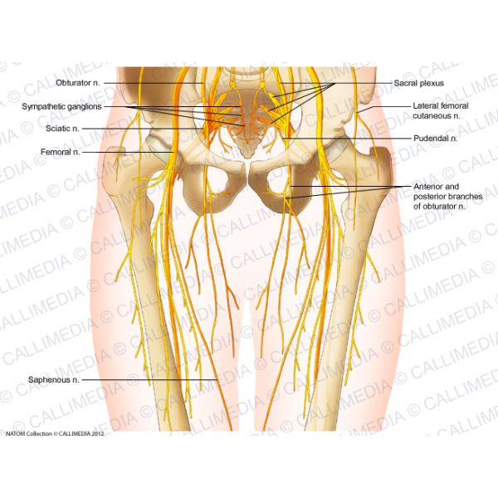
NERVE SUPPLY

Slide 17
MOVEMENTS AND RANGE

Slide 18
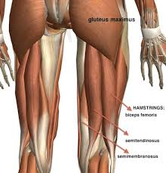
FLEXORS
EXTENSORS

Slide 19
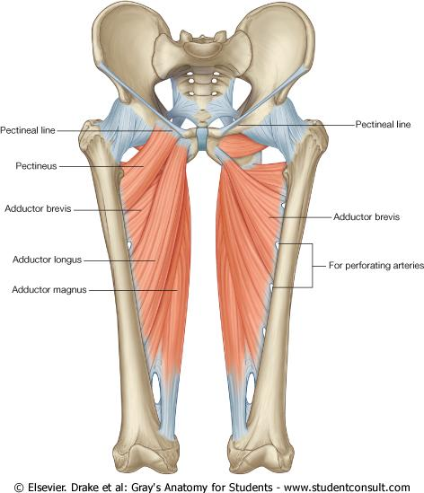
ABDUCTORS
ADDUCTORS

Slide 20
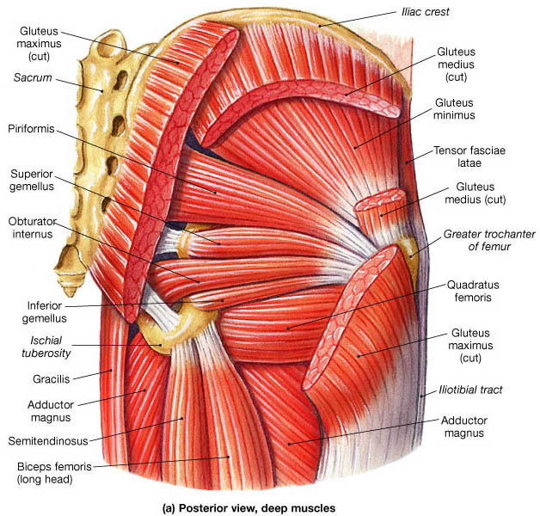
LATERAL ROTATORS
MEDIAL ROTATORS

Slide 21
APPLIED ASPECTS
Dislocation(congenital,acquired)
Perthes disease(pseudocoxalgia)
Coxa vera and coxa valga
Osteoarthritis
Fracture neck femur

Slide 22
CONGENITAL DISLOCATION
Loose joint capsule
Hypoplastic head
Externally rotated
short limb
Inability to abduct
Assymmetry of skin folds of thigh

Slide 23
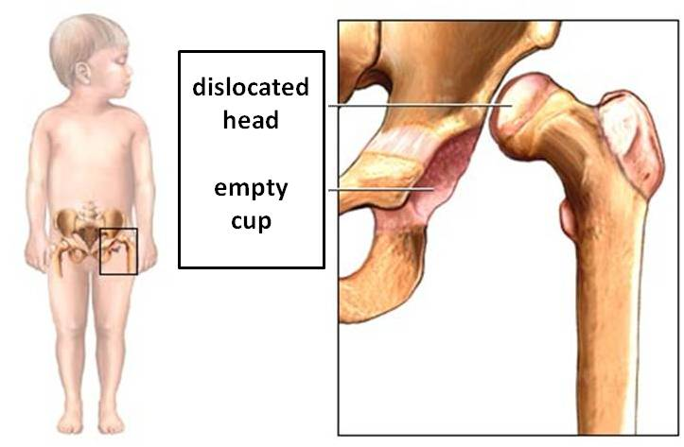
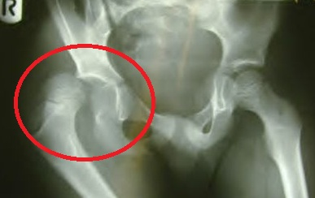
AQUIRED DISLOCATION
Posterior(most common)
Joint flexed, adducted, medially rotated –
Traumatic- Car driver, dashboard strike-Femur head forced out of acetabulum ,capsule tear is posterioinferiorly.

Slide 24
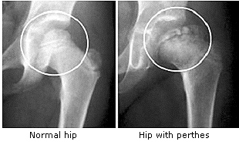
PERTHES DISEASE
Destruction,flattening of head of femur
Increased joint space

Slide 25
COXA VARA
In case of Fracture
femur neck
Perthes disease

Slide 26
COXA VALGA
Seen in congenital dislocation of hip,rickets- softening neck of femur

Slide 27
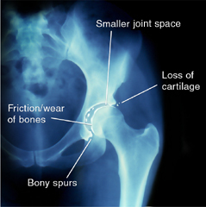
OSTEOARTHRITIS
Old age
Osteophytes grow on
articular ends-
painful, limiting movement .

Slide 28
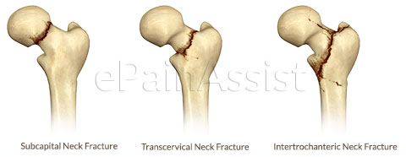
FRACTURE NECK OF FEMUR
Intracapsular-
Subcapital(avascular necrosis most common)
Cervical
Basal/intertrochantric
Extracapsular-old age

Slide 29
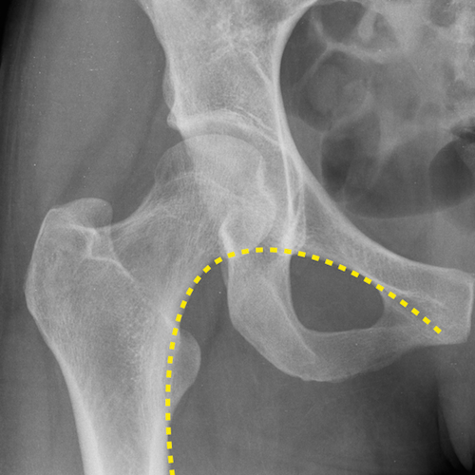
SHENTON’S LINE
DISRUPTED CURVE
In case of dislocation and in fracture neck femur.
Notes:
shento

Slide 30
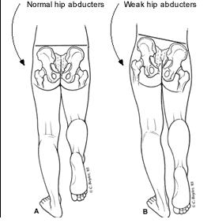
TRENDELENBURG SIGN

Slide 31
SHOEMAKER’S LINE
Straight line from tip of greater trochanter to ASIS upto umblicus.
If G.T. elevated in fracture neck
Line passes below umblicus.
Notes:
shoe

Slide 32
MCQ’S

Slide 33
Iliofemoral ligament takes origin from
A. Iliopubic rami
B. Posterior inferior iliac spine
C. Anterior superior iliac spine
D. Anterior inferior iliac spine

Slide 34
Lurching gait is seen and trendelenburg sign is positive in paralysis of all EXCEPT
A. Gluteus maximus
B. Gluteus minimus
C. Gluteus medius
D. Tensor fasciae latae

Slide 35
Amongst the following muscles which muscle is a medial rotator of thigh
A. Quardratus femoris
B. Piriformis
C. Gluteus medius
D. Obturator internus

Slide 36
The hip joint most commonly dislocates in the following direction
A. anterior
B. posterior
C. superior
D. inferior

Slide 37
Hyperextension at hip joint is prevented by
A. Iliofemoral ligament
B. Ischiofemoral ligament
C. Pubofemoral ligament
D. Capsular ligament

